Slide 1


2021 International Conference on Smart Generation Computing, Communication and Networking (SMARTGEN) (SMARTGENCON 2021) Hosted By
BM25 Algorithm Driven Search Tool for Linking Exploits to Vulnerabilities
Paper ID: 1698
Presenter name: Aditya Ambekar
Affiliation: Centre of Excellence in Complex and Nonlinear
Dynamical Systems, VJTI, Mumbai, INDIA

Slide 2
Contents
Introduction
Motivation
Contribution
Methodology
Model Proposed
Tool Architecture

Slide 3
Introduction
The cyber attacks cost around 1 trillion to global economy.
On an average around 50 CVE’s are published and around 6% of total known vulnerabilities are exploited yearly.
Currently organisations prioritises vulnerability assessment tools as a step towards Cyber Threat Intelligence.
Also these organisations depend upon reactive intelligence for the detection of exploit for the vulnerability, but due to increasing attacks there is a need for a proactive approach.

Slide 4
Motivation
Our systems should be flexible enough to adapt in order to be robust against the exploits of the ever-increasing vulnerabilities.
In order to automate this process, the first step is to identify the exploits of the vulnerabilities that are being added everyday.
However crucial it seems, we found no support of associating exploits to vulnerabilities even on well-known open source platforms like NVD, cve-mitre, exploit-db, etc.

Slide 5
Contribution
Developed and proposed model to link exploits to vulnerabilities and vice versa inspired by the EVA-DSSM model.
Developed a tool to list relevant vulnerabilities for a given exploit and vice a versa.
Support of continuous integration of new vulnerabilities and exploits, thereby keeping the tool up to date.

Slide 6
Methodology
For this work, the vulnerabilities data was scraped from the securityfocus.com and the exploits data collected from exploit-db.com.
Over 126k vulnerabilities and 50k exploits were collected.
For the supervised models, the matching 3k vulnerability-exploit pairs were generated using the python script and 2k pairs were collected from cve-mitre.org.
Only the title of the vulnerabilities and the exploits were considered for the research work.

Slide 7
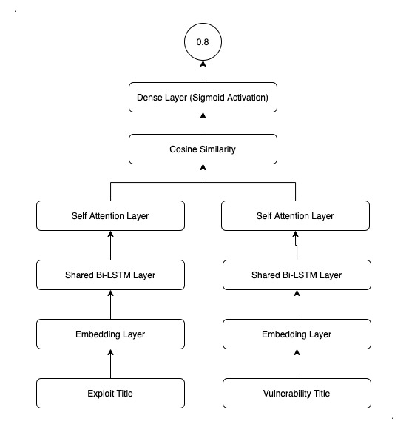
Model Proposed - 1
The exploit and vulnerability titles are passed through the input and embedding layer to create embeddings. These embeddings of each vulnerability and exploit are then fed to a bidirectional LSTM layer to develop an overall context and passed through self-attention layer and then calculate the cosine similarity between the titles.

Slide 8
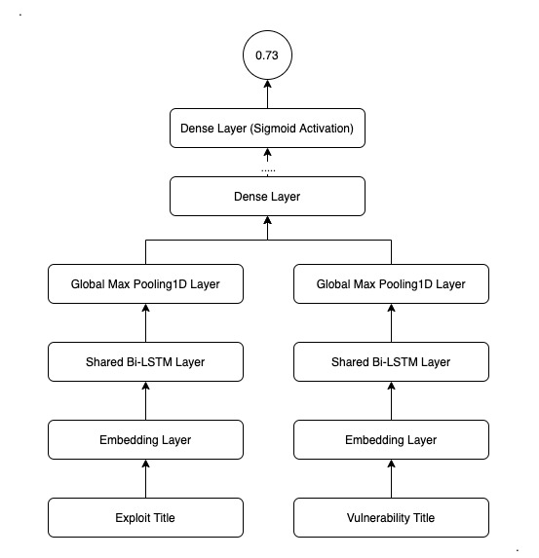
Model Proposed - 2
This model is based on siamese network.
The weights of the layers are shared as there is a similarity between the titles.
For reducing the calculation, here max pooling layer is used instead of self-attention layer.

Slide 9
Requirements for tool model
Learn the semantics of the titles
Return relevant results to users even if they have not searched for the specific words within these results.
Be able to scale up to larger datasets as there are going to be vulnerabilities and exploits added continuously.
Be orders of magnitude faster than our last implementation, even when searching over large datasets.
Handle spelling mistakes, typos, and previously 'unseen' words intelligently because most of the hackers are non-English, so there are high chances that there might be spelling mistakes in it.

Slide 10
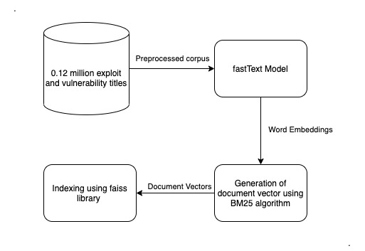
Tool Architecture
fastText model for creating the embeddings for the corpus.
BM25 to power the search.
Faiss library to index the document vectors.

Slide 11
Tool Features
The tool provides user to query for relevant vulnerabilities and exploits.
Provides an option to add vulnerabilities/ exploits to the database, individually or grouped in the form of an excel sheet.
A feature to automate scraping of new exploits published on the site of exploit-db (for admin purpose).

Slide 12
Thank you

